Slide 1


SpaceX Launch Success Prediction
Iaroslava Mizai
2 February 2025

Slide 2
INTRODUCTION
Project Significance:
SpaceX has redefined the aerospace industry by implementing reusable Falcon 9 rockets, drastically lowering launch costs compared to competitors that may charge up to $165 million per launch. By reducing costs to just $62 million through first-stage booster reusability, SpaceX not only achieves exceptional cost efficiency but also sets a transformative benchmark for sustainable space travel.
Main Goal:
This project identifies key factors for safe landings and develops predictive models to forecast future launch outcomes. Accurate predictions of first-stage landings are essential for estimating launch costs and guiding competitive bidding, ultimately enhancing mission planning and ensuring cost-effective, successful launches.
The Impact: Accurate landing predictions can drive substantial cost efficiency, improve mission planning, and unlock new opportunities in the commercial space sector. These predictive insights empower stakeholders to make informed decisions, optimize resource allocation, and mitigate risks—ultimately ensuring the success of future launches.

Slide 3
METODOLOGY: DaTA COLLECTION AND PROCESSING
1. Data Collection Process and Methods
1) SpaceX API
Main data source: SpaceX REST API. Collected detailed information on rockets, payloads, launch sites, and landing outcomes.
Data was processed from raw JSON format into structured tables for easier analysis.
2) API Calls for Specific Data
Additional API requests were made to gather information about rockets, launchpads, payloads, and cores.
This helped enrich the dataset with specific details about booster versions, landing types, and other factors.
3) Web Scraping
Supplemented API data with historical launch data for Falcon 9 and Falcon Heavy from Wikipedia.
Used BeautifulSoup to scrape HTML tables, gathering extra details on payloads, orbits, and mission specifics not covered by the API.
GitHub: https://github.com/DataVizStory/Space-X-Falcon-9-First-Stage-Landing-Prediction/blob/main/1_jupyter-labs-spacex-data-collection-api.ipynb

Slide 4



METODOLOGY: DaTA COLLECTION AND PROCESSING
2. Data Wrangling and Formatting:
Filtering and Cleaning:
Removed irrelevant entries and ensured consistent structure by handling multiple payloads/cores. Replaced missing values using statistical methods, like the mean (e.g., for Payload Mass).
2) Data Normalization: Applied One-Hot Encoding to standardize categorical variables. Reformatted data into a consistent structure with 90 rows and 17 features.
Key Python Libraries and Modules Used
Pandas
for data manipulation and cleaning.
NumPy
for numerical operations.
BeautifulSoup
for API integration
and web scraping.
Datetime
for handling date
and time data.
Datetime
GitHub: https://github.com/DataVizStory/Space-X-Falcon-9-First-Stage-Landing-Prediction/blob/main/2-jupyter-labs-webscraping.ipynb

Slide 5

METODOLOGY: Exploratory data analysis (EDA) using visualization and SQL
1.Exploratory Data Analysis (EDA)
EDA helps identify patterns and insights from raw data, setting the stage for predictive modeling. Combined with SQL, it allowed us to analyze the SpaceX dataset from both statistical and query perspectives, laying a strong foundation for refining predictive models, especially for landing outcomes.
Key Python Libraries and Languages Used
Pandas
for data manipulation and cleaning.
NumPy
for numerical operations.
SQL
language used for managing, manipulating data in relational databases.
GitHub : https://github.com/DataVizStory/Space-X-Falcon-9-First-Stage-Landing-Prediction/blob/main/3_jupyter-labs-eda-sql-coursera_sqllite.ipynb

Slide 6



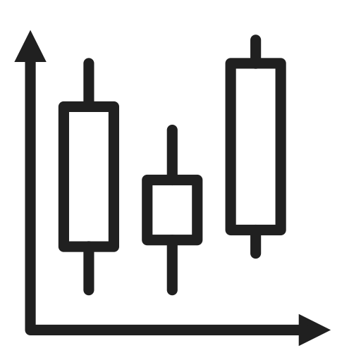
METODOLOGY: Exploratory data analysis (EDA) using visualization and SQL
2. Data visualizations
Data visualizations, such as static graphs and charts, help users quickly understand and interpret data. They present trends, outliers, and patterns in a clear, visual format, making complex information more accessible and supporting better decision-making, even when the data set is large or complicated
Plotted Charts and Their Purpose in the Project
Scatter Plot (Payload vs. Landing Outcome): Highlights the relationship between payload mass and landing success.
Bar Chart (Success Rate by Launch Site): Identifies which sites have the highest probability of a successful landing.
Line Chart (Flight Number vs. Success Rate):
Reveals trends in success rates over multiple launches
Box Plot (Booster Version & Performance):
Compares how different Falcon 9 versions impact landing outcomes.
GitHub: https://github.com/DataVizStory/Space-X-Falcon-9-First-Stage-Landing-Prediction/blob/main/4_edadataviz.ipynb

Slide 7
METODOLOGY: Exploratory data analysis (EDA) using visualization and SQL
3. SQL Queries for SpaceX Data Analysis
1) Launch Sites: The analysis identified several unique launch sites, with a focus on locations like CCAFS LC-40 and VAFB SLC-4E. Notably, records with launch sites starting with 'CCA' were selected, indicating a significant presence at CCAFS LC-40, a key SpaceX launch site.
2) NASA (CRS) Missions: The total payload mass for NASA (CRS) missions was calculated, showing a substantial amount of cargo being launched for NASA, which highlights the importance of SpaceX’s partnership with NASA in the commercial space sector.
3) Booster Performance: The F9 v1.1 booster was analyzed, with its average payload mass computed at around 2928 kg. This indicates its capability in carrying medium payloads, positioning it as a reliable workhorse for various space missions.
4) First Successful Ground Landing: The first successful landing on a ground pad was found to have occurred in 2018, marking a significant milestone in SpaceX's reusability efforts, as they pioneered landing and reusing rocket stages.
5) Drone Ship Landings: A specific analysis of boosters that successfully landed on the drone ship with payload masses between 4000 and 6000 kg revealed several models, further demonstrating SpaceX's ability to manage heavier payloads while maintaining success in drone ship landings.
6) Landing Outcomes: The total count of successful and failed landing outcomes provides insight into SpaceX’s progress and challenges in achieving reusability, showcasing their continuous efforts to improve landing success rates.
GitHub: https://github.com/DataVizStory/Space-X-Falcon-9-First-Stage-Landing-Prediction/blob/main/3_jupyter-labs-eda-sql-coursera_sqllite.ipynb

Slide 8
METODOLOGY: Exploratory data analysis (EDA) using visualization and SQL
3. SQL Queries for SpaceX Data Analysis
Conclusions from the SQL Queries Results:
Launch Sites: There are several unique launch sites, with the majority of launches occurring from locations like CCAFS LC-40 and VAFB SLC-4E, highlighting SpaceX's preference for specific sites.
NASA (CRS) Missions: The total payload mass for NASA (CRS) missions is significant, showing the scale of their collaboration with SpaceX, and their payload capacity in space missions.
Booster Performance: The F9 v1.1 booster has an average payload capacity of around 2928 kg, indicating its role in carrying medium payloads.
Landing Success: The first successful ground pad landing occurred in 2018, marking a major milestone in SpaceX's reuse technology.
Payload Range and Success Rate: Specific boosters (F9 FT versions) have shown success in drone ship landings with payloads between 4000 and 6000 kg, showcasing SpaceX’s ability to manage heavy payloads while achieving successful landings.
Landing Outcomes: The total count of successful and failed landing outcomes provides insights into SpaceX’s landing success rate, which is essential for understanding their reusability efforts and cost efficiency.
GitHub: https://github.com/DataVizStory/Space-X-Falcon-9-First-Stage-Landing-Prediction/blob/main/3_jupyter-labs-eda-sql-coursera_sqllite.ipynb

Slide 9

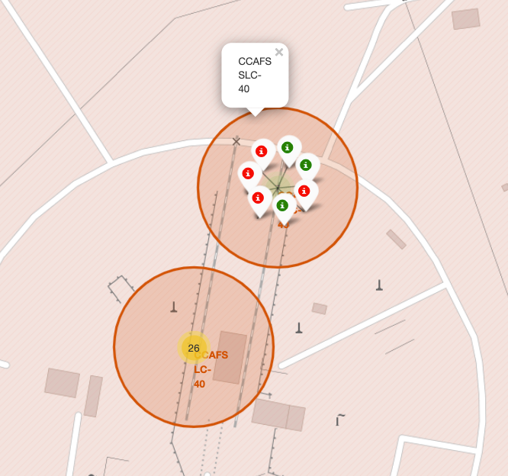
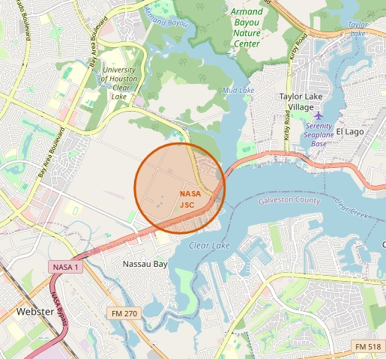
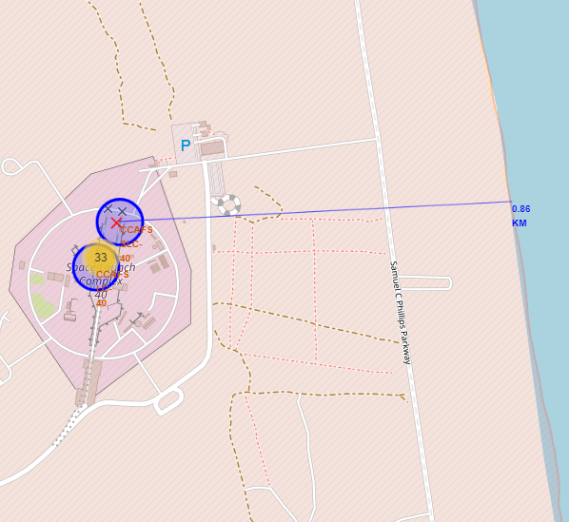
METODOLOGY: Interactive Map with Folium
Folium is a Python library for creating interactive maps. In this project, it visualizes SpaceX launch sites, adding markers and geographic insights. Users can explore locations, zoom in, and view site details interactively.
Map Elements and Markers. Their Purpose in the Project
Point Markers :
Identify key SpaceX launch locations
Circle Markers :
Visualize past landing outcomes at each site.
Polylines (Distance Lines):
Show proximity of launch sites to key locations (e.g. coastlines, cities, railways and more )
GitHub: https://github.com/DataVizStory/Space-X-Falcon-9-First-Stage-Landing-Prediction/blob/main/5_lab_jupyter_launch_site_location.ipynb

Slide 10
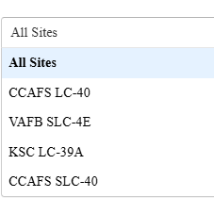
METODOLOGY: Build a Dashboard with Plotly DasH
SpaceX Launch Analysis Dashboard – Summary and Insights
Pie Chart: Displays the success rate of launches. If "All Sites" is selected, it shows the total successful launches per site. If a specific site is selected, it visualizes the success vs. failure rate for that site.
The pie chart provides a high-level overview of launch success distribution, helping to quickly identify which sites have higher success rates.
Scatter Plot: Shows the relationship between payload mass and launch success. The color categorization represents different booster versions.
The scatter plot highlights trends between payload mass and launch outcomes, aiding in understanding the impact of payload size on mission success.
Range Slider: Enables selection of payload mass range for analysis.
The dropdown and slider enable user-driven exploration, making the dashboard more interactive and insightful.
GitHub: https://github.com/DataVizStory/Space-X-Falcon-9-First-Stage-Landing-Prediction/blob/main/6_spacex_dash_app.py

Slide 11
METODOLOGY: Predictive Analysis (Classification)
SpaceX Launch Analysis Dashboard – Summary and Insights
Model Development and Optimization
Built multiple models: Logistic Regression, SVM, Decision Tree, KNN.
Evaluated using accuracy, precision, recall, and F1-score for each of this model.
Improved performance through hyperparameter tuning and feature selection.
Process Summary
Data Preprocessing
Best Model Selection
Model Training
Model Testing
Evaluation
Optimization
Logistic Regression was identified as the best model due to its high accuracy (83.33%) and stability.
It effectively generalizes the data and provides interpretability for predicting successful SpaceX launches.
GitHub: https://github.com/DataVizStory/Space-X-Falcon-9-First-Stage-Landing-Prediction/blob/main/7_SpaceX_Machine%20Learning%20Prediction_Part_5.ipynb

Slide 12
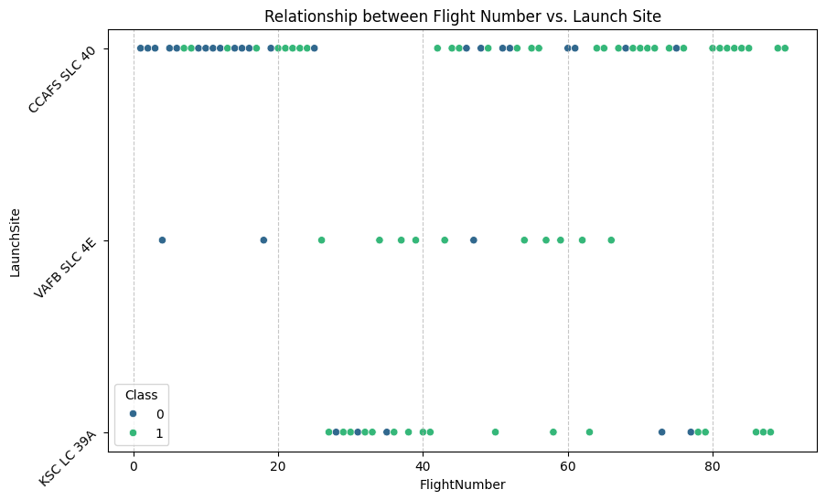
INSIDES DROWN FROM EDA
Flight Number vs. Launch Site (Scatter Plot)
This scatter plot illustrates the relationship between Flight Number and Launch Site, showing successful (1) and unsuccessful (0) landings.
CCAFS SLC-40: The most frequently used launch site, with a mix of successes and failures.
VAFB SLC-4E: Fewer launches, with some successful landings.
KSC LC-39A: A high concentration of successful landings.
Trend: Higher flight numbers tend to have more successes, likely due to improved technology and operational experience. This visualization highlights SpaceX’s progress in landing reliability across different launch sites.
GitHub: https://github.com/DataVizStory/Space-X-Falcon-9-First-Stage-Landing-Prediction/blob/main/4_edadataviz.ipynb

Slide 13
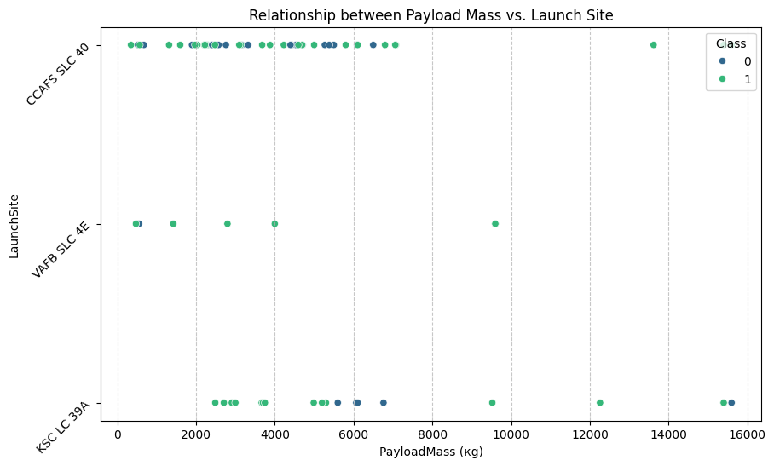
INSIDES DROWN FROM EDA
Payload vs. Launch Site (Scatter Plot)
Key Observations:
CCAFS SLC 40 and KSC LC 39A have more launches compared to VAFB SLC 4E.
Successful landings (green dots) are more frequent for medium payloads (between 2000 kg and 8000 kg).
Heavier payloads (>10,000 kg) have a mix of successful and unsuccessful landings, indicating higher difficulty in recovery.
VAFB SLC 4E has fewer launches, with most of them being successful.
Some payload masses show both successful and unsuccessful landings, suggesting other factors influence the landing success.
This plot highlights the relationship between payload mass and landing success across different launch sites. While medium payloads tend to have higher success rates, heavier payloads pose a greater challenge for first-stage recovery.
GitHub: https://github.com/DataVizStory/Space-X-Falcon-9-First-Stage-Landing-Prediction/blob/main/4_edadataviz.ipynb

Slide 14
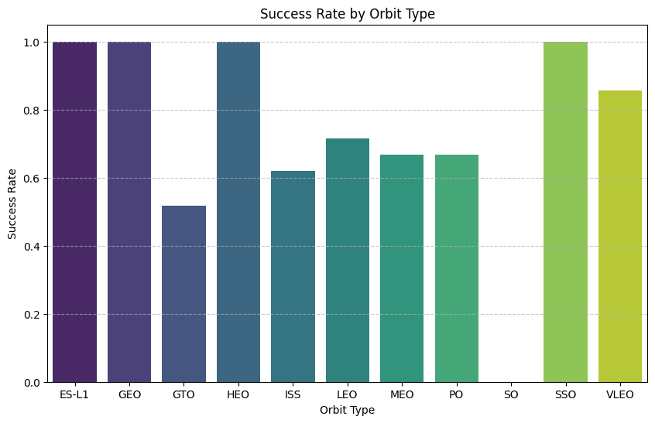
INSIDES DROWN FROM EDA
Key Observations:
Certain orbits, such as ES-L1, GEO, HEO, and SSO, have a 100% success rate, indicating strong reliability in these missions.
GTO (Geostationary Transfer Orbit) has the lowest success rate, suggesting that missions to this orbit pose higher challenges for first-stage recovery.
LEO (Low Earth Orbit), MEO (Medium Earth Orbit), and PO (Polar Orbit) have moderate success rates (around 60-70%), indicating room for improvement.
SSO (Sun-Synchronous Orbit) and VLEO (Very Low Earth Orbit) exhibit high success rates, above 80%, showing promising landing performance in these missions.
ISS (International Space Station) resupply missions show a success rate above 60%, reflecting operational efficiency but also some landing challenges.
This analysis highlights how orbit type influences landing success. While some orbits exhibit near-perfect recovery rates, others—especially GTO and mid-altitude orbits—face greater challenges.
Success Rate by Orbit Type (Bar chart)
GitHub: https://github.com/DataVizStory/Space-X-Falcon-9-First-Stage-Landing-Prediction/blob/main/4_edadataviz.ipynb

Slide 15
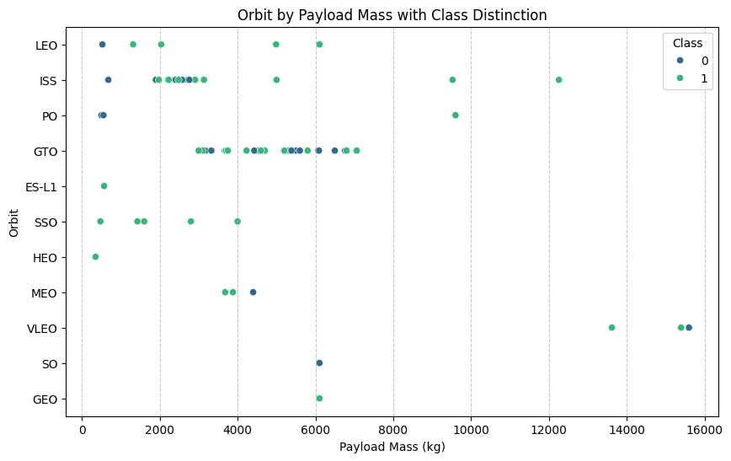
INSIDES DROWN FROM EDA
Orbit by Payload Mass with Class Distinction (Scatter Plot)
Key Observations:
GTO (Geostationary Transfer Orbit) has a mix of successful and unsuccessful landings, with payloads mostly around 4000-6000 kg. This suggests landing success in GTO missions is inconsistent.
LEO (Low Earth Orbit) and ISS missions show relatively more successful landings, even for lower payload masses.
Heavier payloads (>10,000 kg) appear in orbits like GEO and GTO, with mixed landing results, indicating difficulty in recovering the first stage for heavier launches.
SSO, ES-L1, and VLEO mostly show successful landings, suggesting better recovery efficiency for these orbit types.
Some orbit types (like SO and GEO) have fewer data points, meaning fewer missions were conducted to these orbits.
This plot demonstrates how payload mass and orbit type affect first-stage landing success. While lower payloads tend to have higher landing success, heavier payloads—especially in GTO and GEO missions—face greater recovery challenges.
GitHub: https://github.com/DataVizStory/Space-X-Falcon-9-First-Stage-Landing-Prediction/blob/main/4_edadataviz.ipynb

Slide 16
INSIDES DROWN FROM EDA
Orbit by Payload Mass with Class Distinction (Scatter Plot)
Key Observations:
LEO (Low Earth Orbit) and ISS missions show a higher frequency of successful landings, especially for payloads under 6000 kg.
GTO (Geostationary Transfer Orbit) has a mix of successes and failures, particularly around 4000-6000 kg, indicating variability in landing success.
Heavier payloads (>10,000 kg) are mostly associated with GTO, GEO, and some SSO missions, with mixed landing outcomes.
Orbits like ES-L1, SSO, and HEO tend to have higher landing success rates.
Some unsuccessful landings (blue dots) are observed in SO, GEO, and MEO missions, indicating challenges for recovery in these orbits.
This plot highlights the relationship between orbit type, payload mass, and landing success. While LEO and ISS missions have better recovery rates, heavier payloads—particularly in GTO and GEO missions—face greater challenges in first-stage landing success. This analysis can help optimize mission planning and improve recovery strategies for future launches.
GitHub: https://github.com/DataVizStory/Space-X-Falcon-9-First-Stage-Landing-Prediction/blob/main/4_edadataviz.ipynb

Slide 17
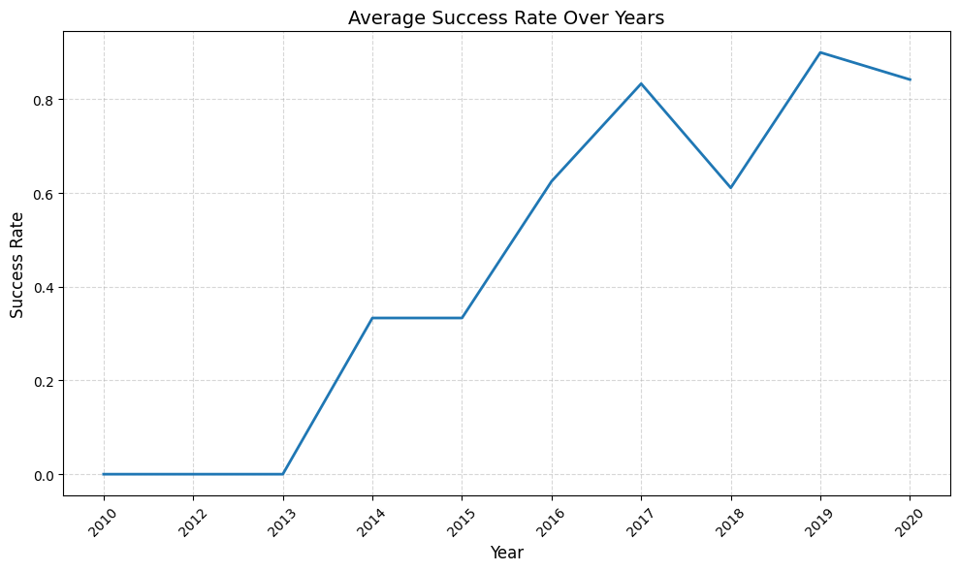
INSIDES DROWN FROM EDA
Average Success Rate Over Years (Line chart)
Key Observations:
2010-2013: The success rate was 0, meaning no successful landings were achieved in these years.
2014-2016: A gradual increase in success rate, reaching above 60% by 2016, indicating improvements in landing technology and execution.
2017: The success rate peaked at over 80%, showing a major breakthrough in landing reliability.
2018: A drop in success rate (around 60%), possibly due to specific mission challenges or experimental tests.
2019-2020: The success rate rebounded to its highest point (~90%) before a slight decline in 2020.
This plot highlights SpaceX's progress in first-stage recovery technology over a decade. After initial failures, steady improvements led to a success rate exceeding 80% by 2019. The temporary drop in 2018 suggests operational challenges, but the overall trend demonstrates increasing reliability in Falcon 9 landings.
GitHub: https://github.com/DataVizStory/Space-X-Falcon-9-First-Stage-Landing-Prediction/blob/main/4_edadataviz.ipynb

Slide 18
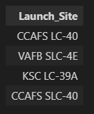

INSIDES FROM SQL ANALYSIS
Unique launch sites
Total payload carried by boosters from NASA
All launch sites are shown, highlighting the distribution of missions across different locations
The total payload mass across all missions is 48,213 kg
GitHub: https://github.com/DataVizStory/Space-X-Falcon-9-First-Stage-Landing-Prediction/blob/main/3_jupyter-labs-eda-sql-coursera_sqllite.ipynb

Slide 19
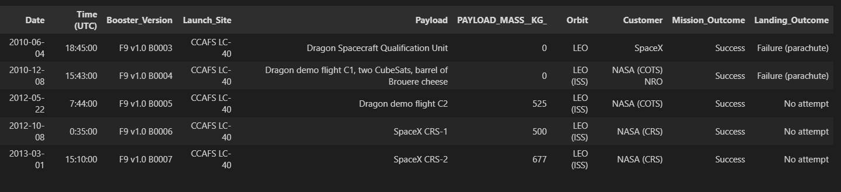
INSIDES DROWN FROM EDA
5 records where launch sites begin with `CCA`
The dataset contains detailed records from SpaceX's early missions, including information such as launch dates, times, launch sites, payload details, and landing outcomes. The goal was to gain a deeper understanding of the mission characteristics and outcomes using SQL queries.
GitHub: https://github.com/DataVizStory/Space-X-Falcon-9-First-Stage-Landing-Prediction/blob/main/3_jupyter-labs-eda-sql-coursera_sqllite.ipynb

Slide 20

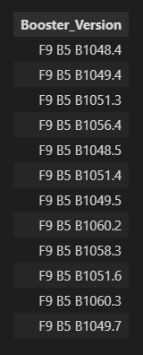


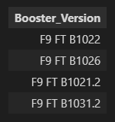
INSIDES DROWN FROM EDA
Average payload mass carried by booster version F9 v1.1
The average payload mass is calculated to be 2928.4 kg.
List the names of the booster which have carried the maximum payload mass
Date of the first successful landing
outcome on ground pad
Total number of successful and failure mission outcomes
List the names of boosters which have successfully landed on drone ship and had payload mass greater than 4000 but less than 6000
GitHub: https://github.com/DataVizStory/Space-X-Falcon-9-First-Stage-Landing-Prediction/blob/main/3_jupyter-labs-eda-sql-coursera_sqllite.ipynb

Slide 21
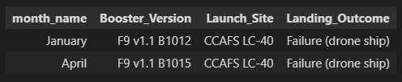
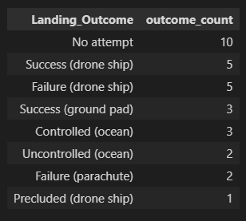
INSIDES DROWN FROM EDA
List the failed landing outcomes in drone ship, their booster versions, and launch site names for in year 2015
Rank the count of landing outcomes (such as Failure (drone ship) or Success (ground pad)) between the date 2010-06-04 and 2017-03-20, in descending order
This approach offers a thorough examination of SpaceX mission data, leveraging SQL queries to address specific questions and deliver a well-organized, detailed analysis
GitHub: https://github.com/DataVizStory/Space-X-Falcon-9-First-Stage-Landing-Prediction/blob/main/3_jupyter-labs-eda-sql-coursera_sqllite.ipynb

Slide 22
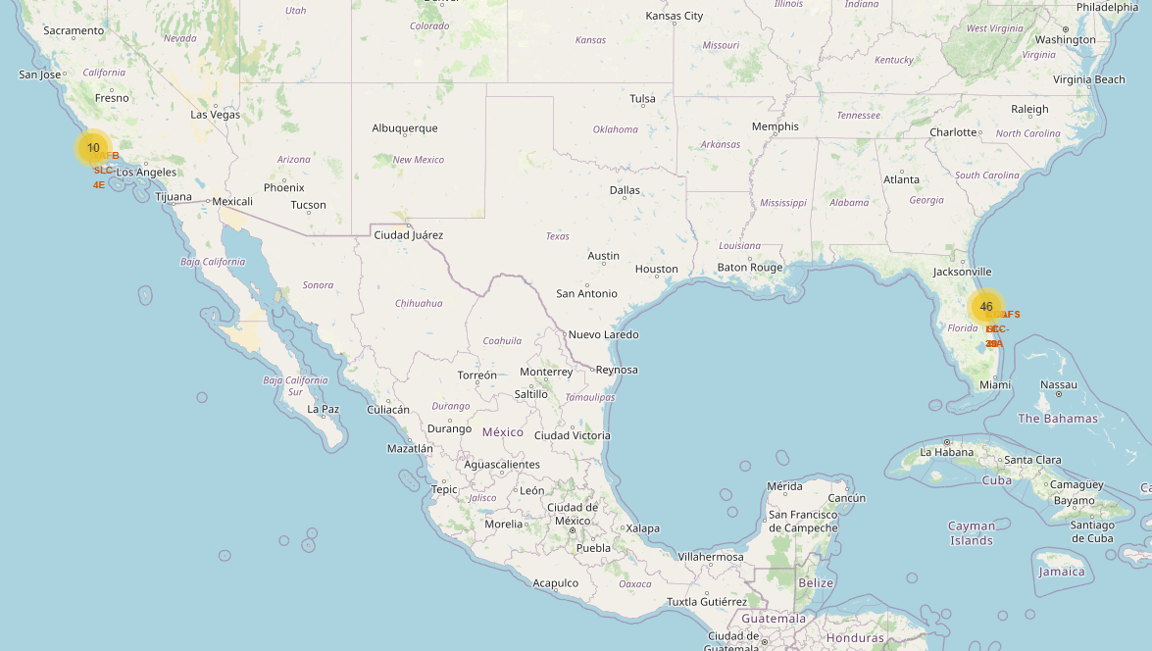
INSIDES DROWN FROM FOLIUM MAP
Launch Site Locations
All SpaceX launch sites are marked on the map with blue circles and labeled markers, providing a clear view of their geographic spread. The map highlights the functional roles of each site, such as VAFB for polar orbits and the Florida locations for equatorial orbits, demonstrating SpaceX's strategic decisions for efficient operations. These sites are also strategically placed near coastlines to ensure safety during launches.
GitHub: https://github.com/DataVizStory/Space-X-Falcon-9-First-Stage-Landing-Prediction/blob/main/5_lab_jupyter_launch_site_location.ipynb

Slide 23
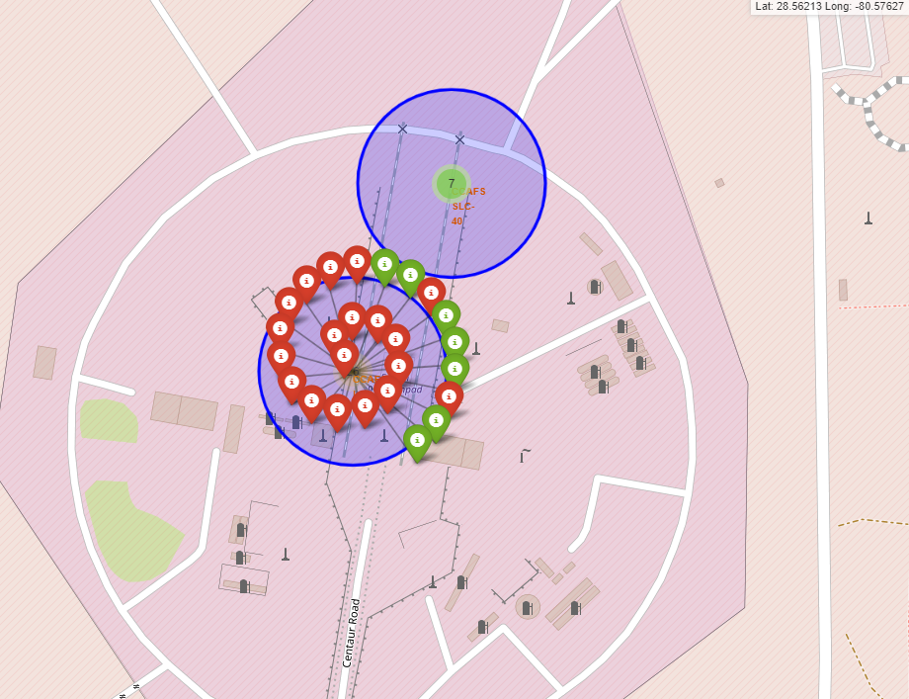
INSIDES DROWN FROM FOLIUM MAP
Success and Failure Visualization
Marker clusters represent individual launches.
Green markers for successful launches and red markers for failures, allowing for a quick overview of performance trends at each site.
GitHub: https://github.com/DataVizStory/Space-X-Falcon-9-First-Stage-Landing-Prediction/blob/main/5_lab_jupyter_launch_site_location.ipynb

Slide 24
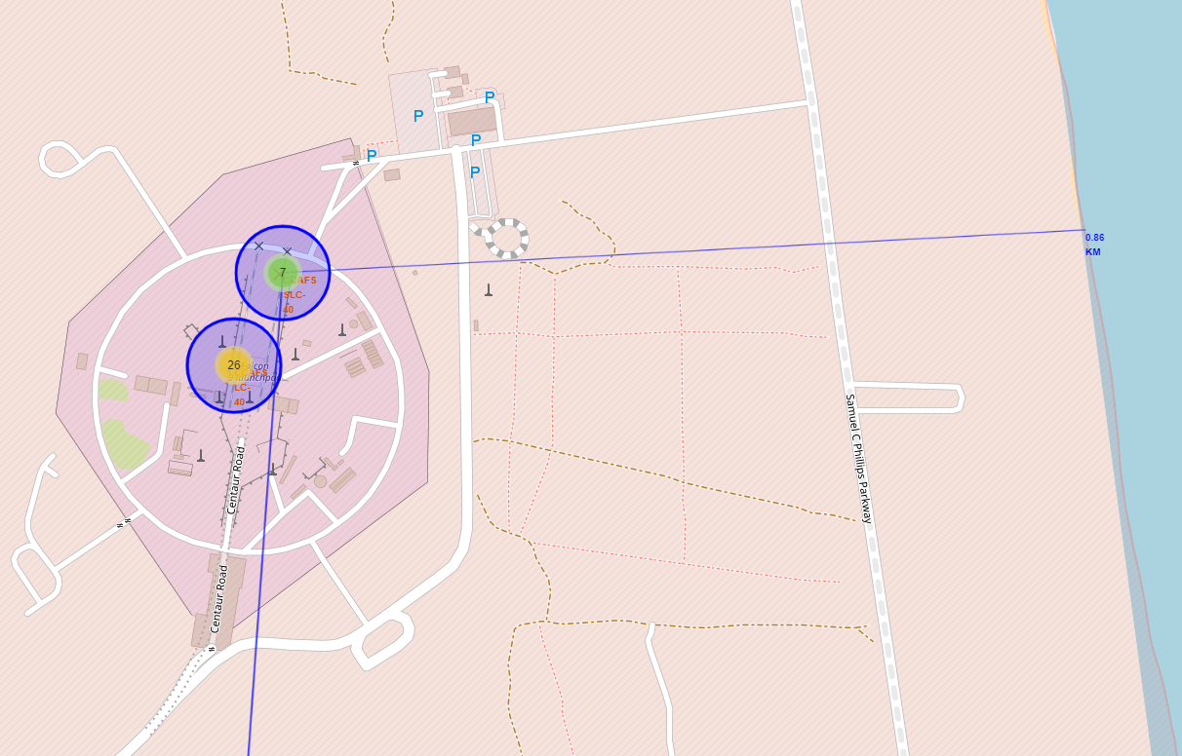
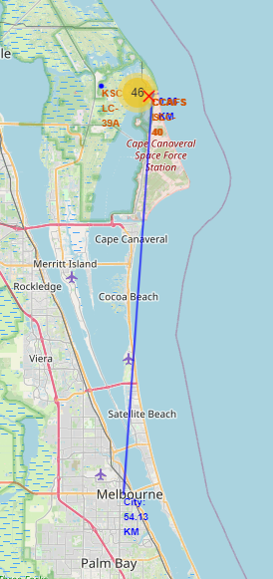
INSIDES DROWN FROM FOLIUM MAP
Distance from Launch Site to coastline and city
Blue lines show
calculated distances to nearby features (for example ) city and coastline)
emphasizing the strategic design and
operational planning of each site.
GitHub: https://github.com/DataVizStory/Space-X-Falcon-9-First-Stage-Landing-Prediction/blob/main/5_lab_jupyter_launch_site_location.ipynb

Slide 25
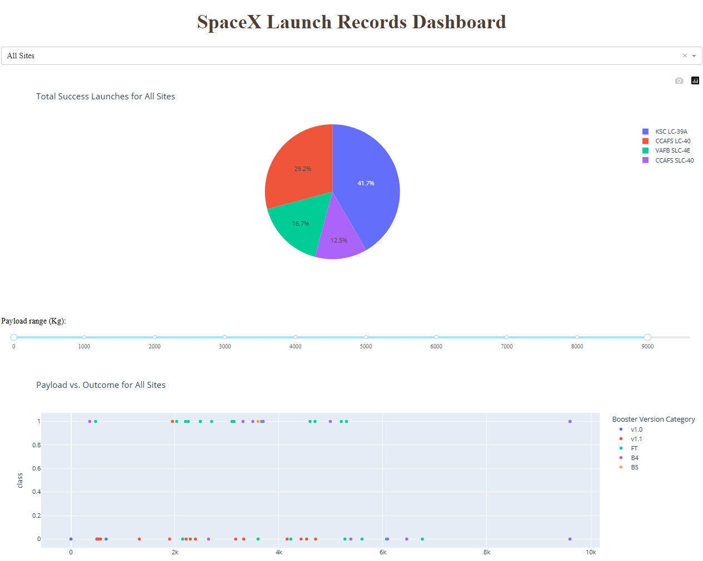
INSIDES FROM PLOTLY DASHBOARD
A pie chart on the dashboard displays the total number of successes either by individual site or for all sites combined.
A scatter plot illustrates the correlation between payload mass and launch outcomes, with options to filter by site and adjust the payload range.
The dashboard also includes a dropdown menu for selecting a site and a slider for adjusting the payload range.
GitHub: : https://github.com/DataVizStory/Space-X-Falcon-9-First-Stage-Landing-Prediction/blob/main/6_spacex_dash_app.py

Slide 26
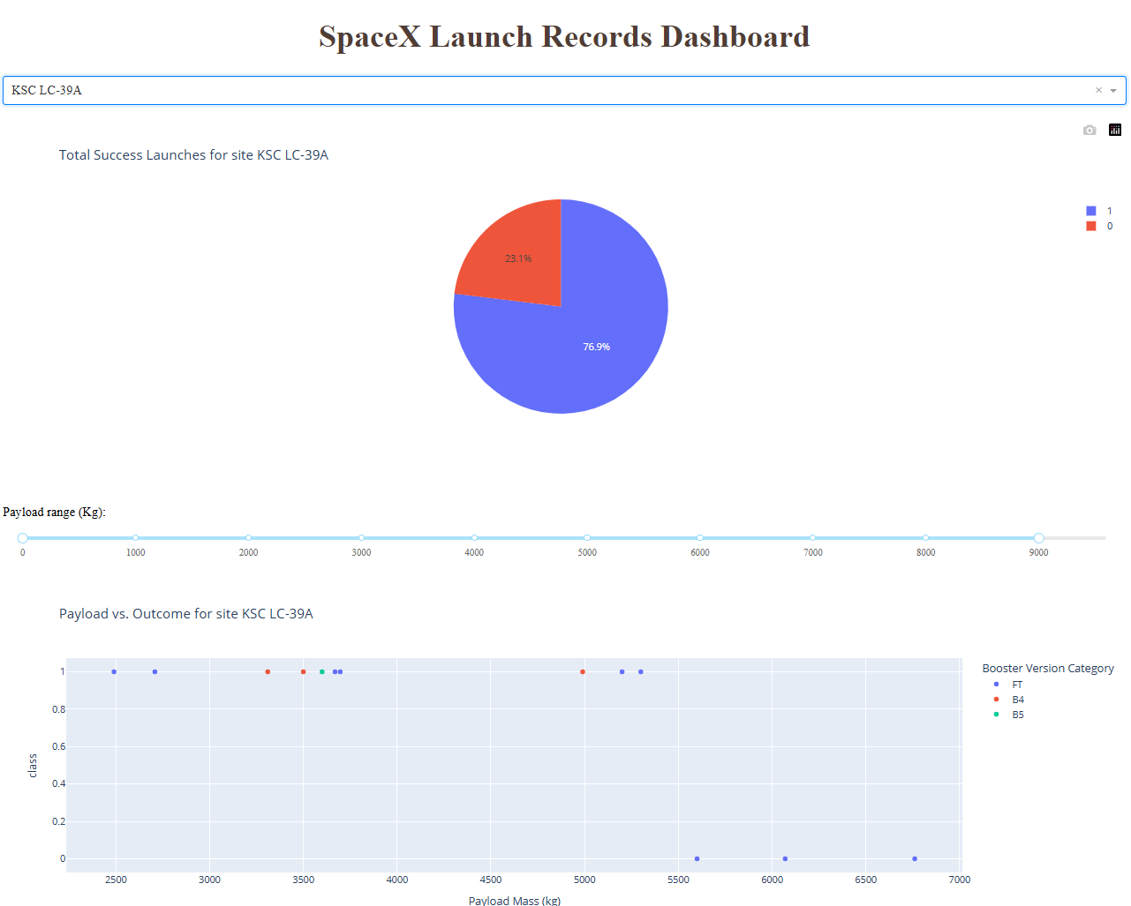
INSIDES FROM PLOTLY DASHBOARD
The launch site with highest launch success ratio
GitHub: : https://github.com/DataVizStory/Space-X-Falcon-9-First-Stage-Landing-Prediction/blob/main/6_spacex_dash_app.py

Slide 27
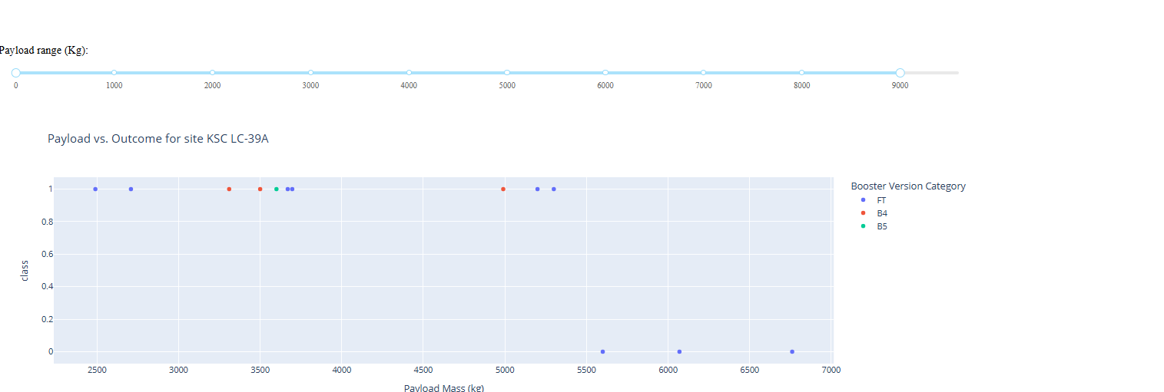
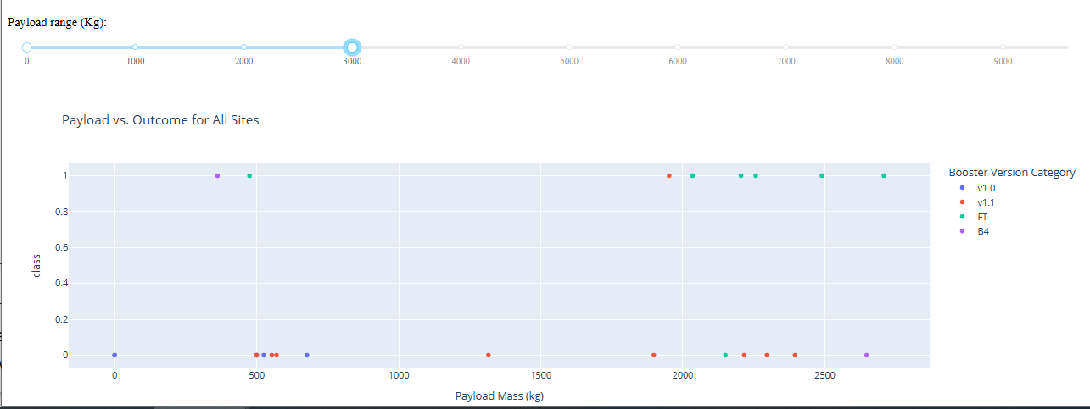
INSIDES FROM PLOTLY DASHBOARD
Payload vs. Launch Outcome scatter plot for all sites, with different payload selected in the range slider
GitHub: : https://github.com/DataVizStory/Space-X-Falcon-9-First-Stage-Landing-Prediction/blob/main/6_spacex_dash_app.py

Slide 28
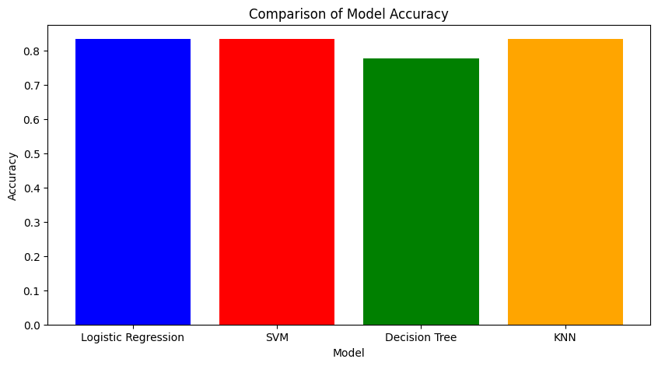
Predictive Analysis (classification)
Best Models: Logistic Regression, SVM, and KNN all achieved the highest accuracy of 83.33%, making them the best-performing models.
Lower Performance: The Decision Tree model had a slightly lower accuracy of 77.78%, suggesting it may have overfitted the training data or struggled with generalization.
Stability and Interpretability: Logistic Regression was chosen as the best model due to its ability to generalize well and provide interpretability, making it useful for understanding key factors influencing successful landings.
GitHub: https://github.com/DataVizStory/Space-X-Falcon-9-First-Stage-Landing-Prediction/blob/main/7_SpaceX_Machine%20Learning%20Prediction_Part_5.ipynb

Slide 29
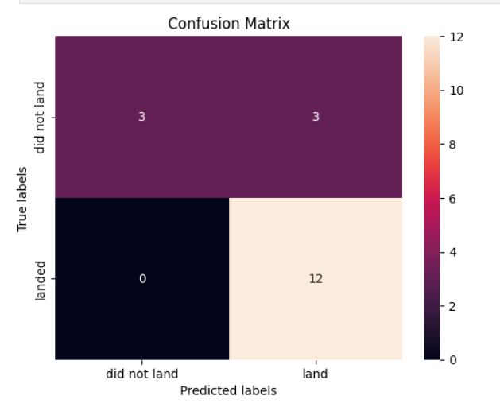
Predictive Analysis (classification)
Logistic Regression was identified as the best model due to its high accuracy (83.33%) and stability.
Key Points of the Confusion Matrix:
True Positives (12): The model correctly predicted 12 successful landings.
True Negatives (3): The model correctly identified 3 cases where the rocket did not land.
False Positives (3): The model predicted a successful landing, but the rocket actually failed to land.
False Negatives (0): No cases where the model predicted failure, but the rocket actually landed.
This model provides high accuracy, reliability, and interpretability, making it an effective tool for predicting SpaceX landings.
GitHub: https://github.com/DataVizStory/Space-X-Falcon-9-First-Stage-Landing-Prediction/blob/main/7_SpaceX_Machine%20Learning%20Prediction_Part_5.ipynb

Slide 30
CONCLUSSION
Predictive Modeling: The use of machine learning models (Logistic Regression) significantly improved the prediction of SpaceX launch success, achieving an impressive 83.4% test accuracy. Logistic Regression model proved effective at identifying factors that impact launch outcomes, such as payload mass, launch site, and orbit type.
Factors Influencing Launch Success: Payload mass, orbit type, and launch sites play a critical role in determining the success of SpaceX missions. Insights from these factors help in predicting launch outcomes with higher accuracy.
Visualization Tools: Interactive dashboards and maps were essential for exploring and visualizing the data, identifying patterns of success and failure, and better understanding how different variables impact launch outcomes. These tools proved valuable for gaining quick insights into mission performance.
SpaceX’s Operational Improvements: SpaceX has continuously improved its launch success rate by optimizing various aspects of its operations, from vehicle design to mission planning. This iterative process has not only improved performance but also contributed to reducing the cost per launch through reusability of Falcon 9 rockets.
Impact on Mission Planning and Cost Efficiency: Accurate launch success predictions are vital for planning future missions. By forecasting the likelihood of success, SpaceX can optimize resource allocation, mitigate risks, and enhance cost-efficiency, leading to better planning for future missions and competitive bidding for space contracts.
Broader Implications: This project demonstrates the potential of data science and machine learning in transforming the aerospace industry by improving the reliability and efficiency of space missions. The predictive insights generated through this project can assist stakeholders in making more informed decisions and furthering the goal of sustainable space exploration.
GitHub: https://github.com/DataVizStory/Space-X-Falcon-9-First-Stage-Landing-Prediction/blob/main/7_SpaceX_Machine%20Learning%20Prediction_Part_5.ipynb

Slide 31
APPENDIX
APPENDIX
SpaceX Official Website 1. https://www.spacex.com
GitHub Repository:
Space-X Falcon 9 First Stage Landing Prediction GitHub Repository
Datasets:
Dataset Part 1
Dataset Part 2
Dataset Part 3
SpaceX Launch Dashboard Dataset
SpaceX Web Scraped Data
Images (Author: Luciano Jung):
Icon by Luciano Jung on Flaticon
Basic Structure Template:
Presentation Template (Coursera)

